Slide 1
North Lake Shore Drive
Task Force Meeting #1
Welcome
Notes:
The Illinois Department of Transportation and the Chicago Department of Transportation are pleased to host this Public Meeting regarding the improvement of North Lake Shore Drive from Grand Avenue to Hollywood Avenue.

Slide 2
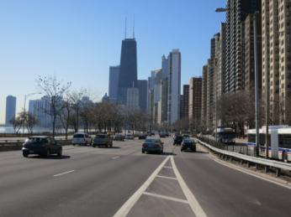
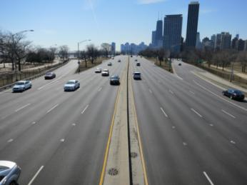
Purpose of Meeting
Task force roles & responsibilities.
Present an overview of study process.
Present a summary of existing conditions.
Solicit input regarding issues and concerns.
Notes:
The purpose of today’s meeting is to present Task Force roles and responsibilities, an overview of the Preliminary Engineering and Environmental Studies process, a summary of existing conditions and to solicit your input.

Slide 3
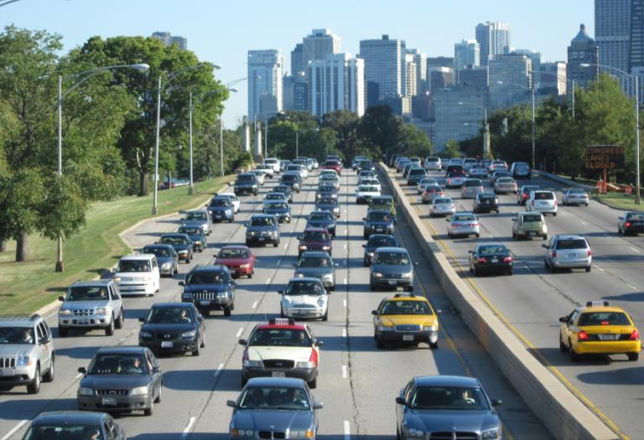
Project Description
Grand Avenue to Hollywood Avenue
11 neighborhoods in 6 wards
7 miles of roadway
22 bridges and tunnels
12 junctions
Northern Terminus Traffic Study
Notes:
The project corridor extends from Grand Avenue to Hollywood Avenue and passes through 11 neighborhoods located in 6 aldermanic wards. The project includes improvements to the Outer Drive including 22 bridges and tunnels and 12 junctions. Junctions are those locations where major cross streets intersect Lake Shore Drive and access is allowed to and from the Outer Drive. In addition, the project will also include improvements to local streets adjacent to the Drive, that are commonly referred to as Inner Lake Shore Drive. Finally, the overall study will include an evaluation of traffic conditions where Lake Shore Drive ends at Hollywood Avenue. This study is referred to as the Northern Terminus Traffic Study.

Slide 4
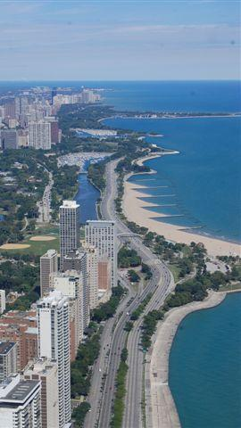
Lake Shore Drive
Affords one of urban America’s
most iconic views of a world
class city and lakefront park.
Critical traffic artery designated
as U.S. Route 41.
Under IDOT Jurisdiction.
Trucks are prohibited.
Notes:
Daniel Burnham’s vision of a “boulevard through a park” has certainly been realized as Lake Shore Drive provides one of urban America’s most iconic views of a world class city and lakefront park. But Lake Shore Drive, which is designated as U.S. Route 41 and is under the jurisdiction of the Illinois Department of Transportation, has also become a critical traffic artery in the City. Though it is a high-volume roadway, it is unique in that all trucks are prohibited from using the Drive.

Slide 5
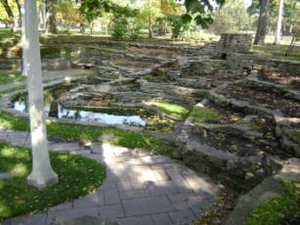
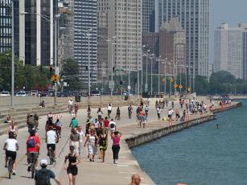
Lincoln Park
One of the crown jewels of
Chicago’s park system.
Listed on the National Register
of Historic Places.
Enjoyed by millions of local and
regional visitors per year.
A chain of local park spaces
heavily used by residents.
Notes:
Today Lincoln Park is considered one of the crown jewels of Chicago’s extensive park system and is listed on the National Register of Historic Places. Although Lincoln Park serves as a regional destination serving millions of visitors each year, it is also a chain of local park spaces for adjacent residents.

Slide 6
Public Involvement Process

Slide 7
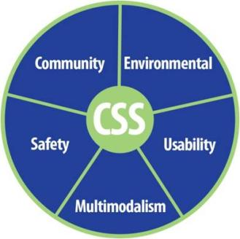
Context Sensitive Solutions (CSS)
Interdisciplinary approach.
Develop transportation facilities
that fit into surroundings or
“context”.
Early, frequent & meaningful
communication with stakeholders.
Flexible and creative approach to design.
Improve safety & mobility.
Preserve and enhance the scenic, economic, historic, and natural qualities.
Notes:
This project is being developed using the principles of IDOT’s Context Sensitive Solutions (CSS) program.
IDOT defines CSS as “an interdisciplinary approach that seeks effective transportation solutions by working with stakeholders to develop, build, and maintain cost-effective transportation facilities that fit into and reflect the project’s surroundings - its “context.” Through early, frequent, and meaningful communication with stakeholders and a flexible and creative approach to design, the resulting projects should improve safety and mobility for the traveling public, while seeking to preserve and enhance the scenic, economic, historic, and natural qualities of the settings through which they pass.”
The CSS process will provide project stakeholders a mechanism to share comments or concerns about transportation objectives and project alternatives, as well as help the project team to understand and address concerns. This integrated approach to problem solving and decision-making will help build a general understanding of the project among interested community members and promote involvement through the study process. Stakeholder involvement is critical to project success.

Slide 8
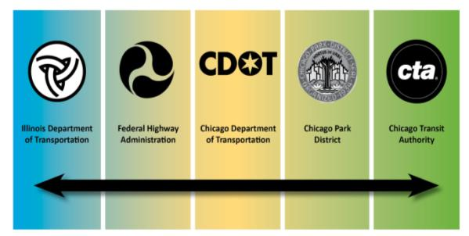
Project Study Group (PSG)
Ensure compliance with design & environmental policies.
Promote partnership with stakeholders.
Work to achieve general project understanding.
Make final project recommendations.
Ultimate decisions are made by IDOT.
Notes:
The Project Study Group, or PSG, consists of a multidisciplinary team of representatives from IDOT, CDOT, FHWA, and the Chicago Park District. As a significant stakeholder, the Chicago Transit Authority has also been included in the PSG. The PSG has primary responsibility for the project development process. This group will meet periodically to provide technical oversight and expertise in key areas including study processes, agency procedures and standards, and technical approaches.
The PSG has primary responsibility for ensuring compliance with all applicable design and environmental policies, and acquiring necessary clearances and approvals from environmental resource agencies. The Project Study Group promotes partnership with stakeholders to address identified project needs and works to achieve a general understanding among all stakeholders. General understanding is defined as a general feeling of agreement where all input is heard and duly considered and the process as a whole was fair. It is important to note that the ultimate decisions on the project remain in the hands of the Illinois Department of Transportation.

Slide 9
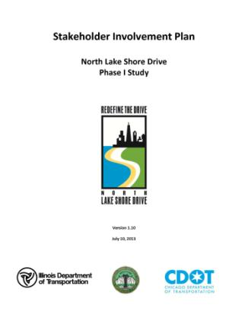
Stakeholder Involvement Plan
Guide for Implementing Context Sensitive Solutions
Decision Making Process
Dynamic Document
Available for Public Review on Website
Notes:
A written Stakeholder Involvement Plan has been prepared to provide a guide for implementing the context sensitive solutions processes. This plan is a blueprint for defining the methods and tools to educate all stakeholders in the decision-making process for this study. The Stakeholder Involvement Plan is a dynamic document that will be updated by the Project Study Group as necessary throughout the Phase I study. The Stakeholder Involvement Plan is available in the exhibit hall for public review, and is also available on the project website.

Slide 10
CSS Outreach Tools
Notes:
The Project Study Group will engage several mechanisms for Public Involvement throughout the course of the Phase I study.
A series of large-scale public meetings, such as the one this evening, will occur throughout the project to inform stakeholders of recent developments in the project, and to seek public input. The Task Forces and Corridor Planning Committee will meet throughout the study. Additional meetings will be held as needed with community organizations, local agencies, and area business or property owners.
A project website, which is listed in the brochure, has been established to keep you informed about all aspects of the project including ongoing studies and upcoming meetings. Any individual or group that shows interest in the project will be added to the stakeholder mailing list, thus ensuring that he or she will receive newsletters, meeting invitations, and project updates. Finally, press releases will be issued as necessary throughout the study period, announcing public meetings, study work to date, important results, and next steps.

Slide 11
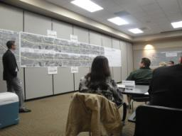
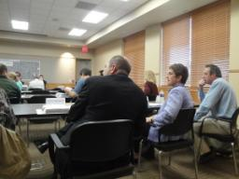
Task Forces
Environmental
Transportation
Park Users
Business & Institutional
Geographic Stakeholders
South: Grand to Diversey
Central: Diversey to Montrose
North: Montrose to Hollywood
Notes:
As part of the outreach process, seven task forces have been created to address the multitude of community needs and issues on this project. While each task force will focus on specific areas of expertise, all relevant information will be shared since many of the issues surrounding this project are interrelated. Task forces have been created that focus on environmental, transportation, park use and business and institutional issues. In addition, three task forces have been created based on geographic boundaries. These boundaries are roughly from Grand to Diversey, Diversey to Montrose and finally, Montrose to Hollywood. These task forces will focus on issues specific to neighborhoods, residents and businesses directly adjacent to Lincoln Park.

Slide 12
Task Force Roles & Responsibilities
Review project materials.
Advise on Problem Statement.
Review and provide input on project alternatives.
Assist in communicating with the public.

Slide 13
Expectations of Task Force
Attend all TF meetings.
Come to the process with an open mind and participate openly and honestly.
Understand that the goal is to achieve a general understanding of issues, viewpoints and potential solutions.
General understanding is defined as a general feeling of agreement that all input is heard and duly considered and the process as a whole was fair.
Accept that once a general understanding is achieved, topics will not continue to be revisited.
Treat each other with respect and dignity.

Slide 14
The Project Process

Slide 15
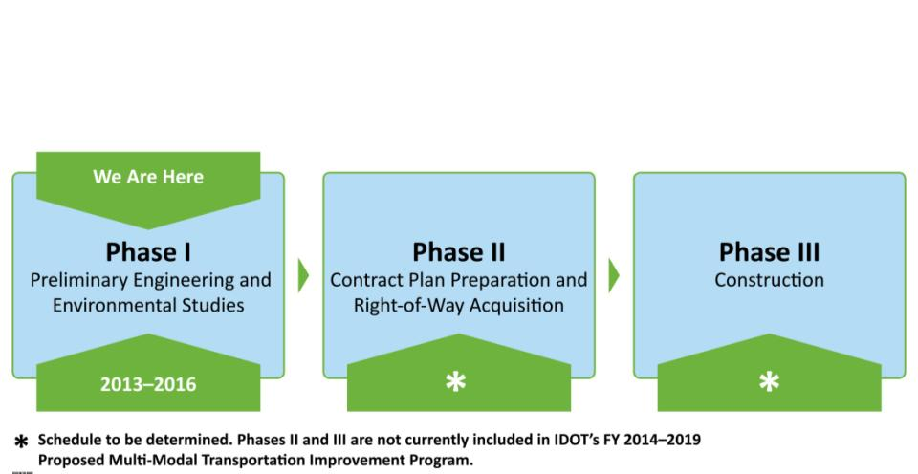
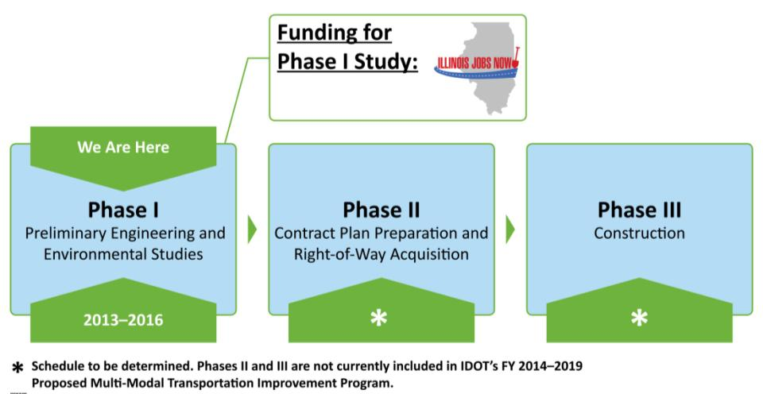
Federal-aid Project Phases
Notes:
Any transportation project that may involve the use of Federal funds must follow a project development process consisting of three phases.
This project is currently in Phase I, which includes extensive environmental and design studies and is described in detail in the next few slides.
After Phase I is complete, Phase II Engineering would begin. During Phase II, detailed construction plans and contracts would be developed and any necessary land would be acquired for the project. Phase III is the physical construction of the project.
Phase I Engineering is being funded by Governor Quinn’s Illinois Jobs Now Program and is anticipated to be completed in 2016. Phases II and III are not currently included in IDOT’s Fiscal Year 2014 through 2019 Proposed Multi-Modal Transportation Improvement Program.

Slide 16
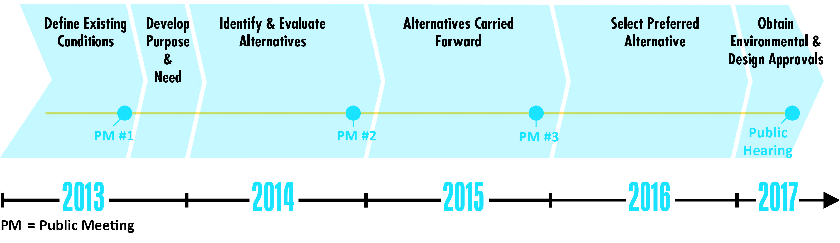
Phase I Study Schedule

Slide 17
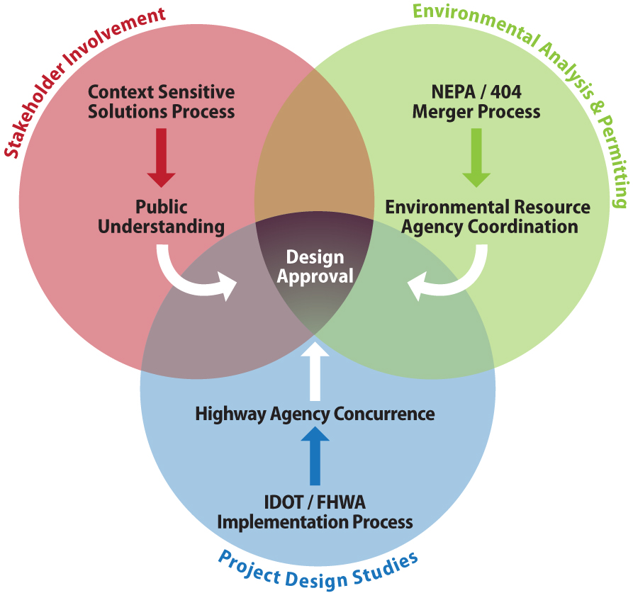
Components of a Phase I Study

Slide 18
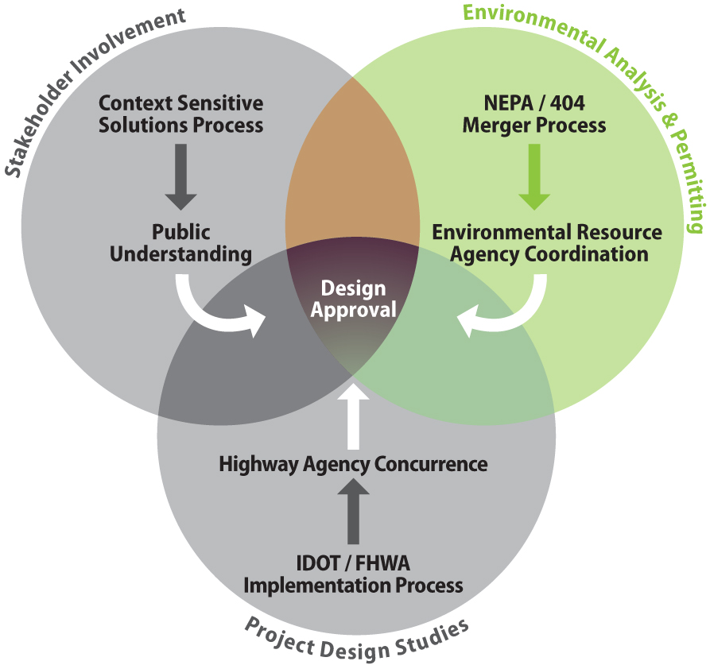
Environmental Analysis & Permitting

Slide 19
National Environmental Policy Act of 1969 (NEPA)
National charter for environmental responsibility for Federal Actions.
Establishes a tiered process for studying the effects of a proposed action on the environment.
Categorical Exclusion (CE)
Environmental Assessment (EA)
Environmental Impact Statement (EIS)
Requires an evaluation of alternatives measured against No-Action conditions.
Necessitates coordination with all regulatory agencies.

Slide 20
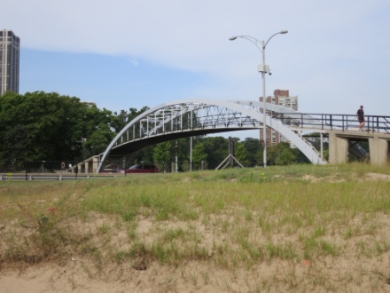
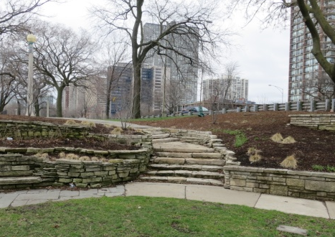
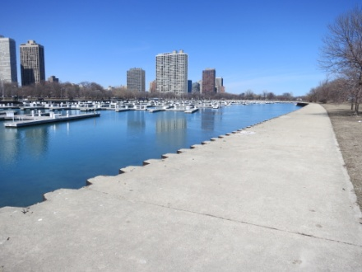
Environmental Considerations
Social
Economic
Historical Resources
Archaeological Resources
Air Quality
Highway Traffic Noise
Plants and Wildlife
Water Quality
Floodplains
Wetlands
Hazardous Waste
Land Use
Parks and Recreation
Soils and Geology
Visual Resources

Slide 21
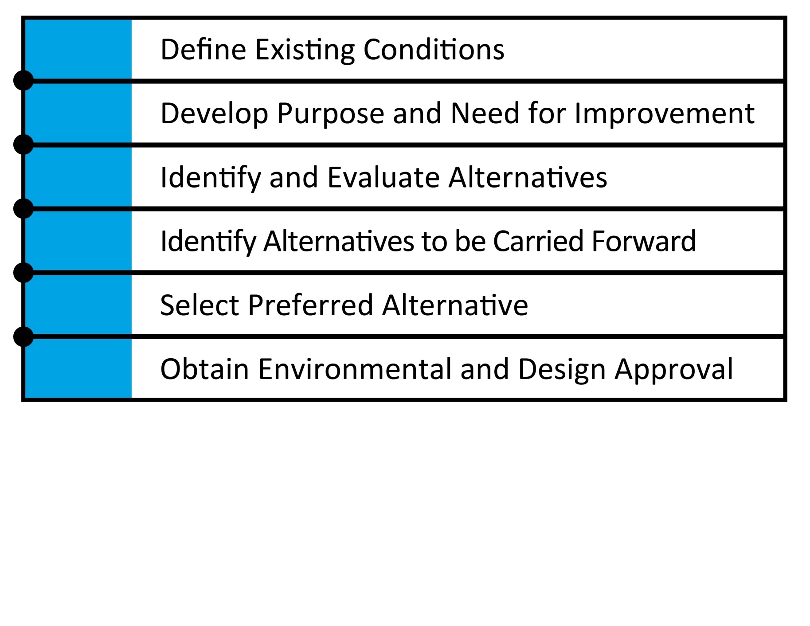
NEPA Milestones
Notes:
A Phase I Study is an in-depth investigation of improvement alternatives which considers social, economic, environmental, safety, serviceability, and cost factors. Several milestones are accomplished during the course of the Phase I Study, the first of which involves performing data collection, surveys, and public involvement in order to define the existing conditions. Next, a concise written purpose and need statement is prepared based on the identified needs. Using the purpose and need statement, improvement alternatives will be identified and evaluated to determine the extent of any environmental impacts. The most viable alternatives will be carried forward for further environmental analysis, and a preferred alternative will be selected.

Slide 22
NEPA Milestones

Slide 23
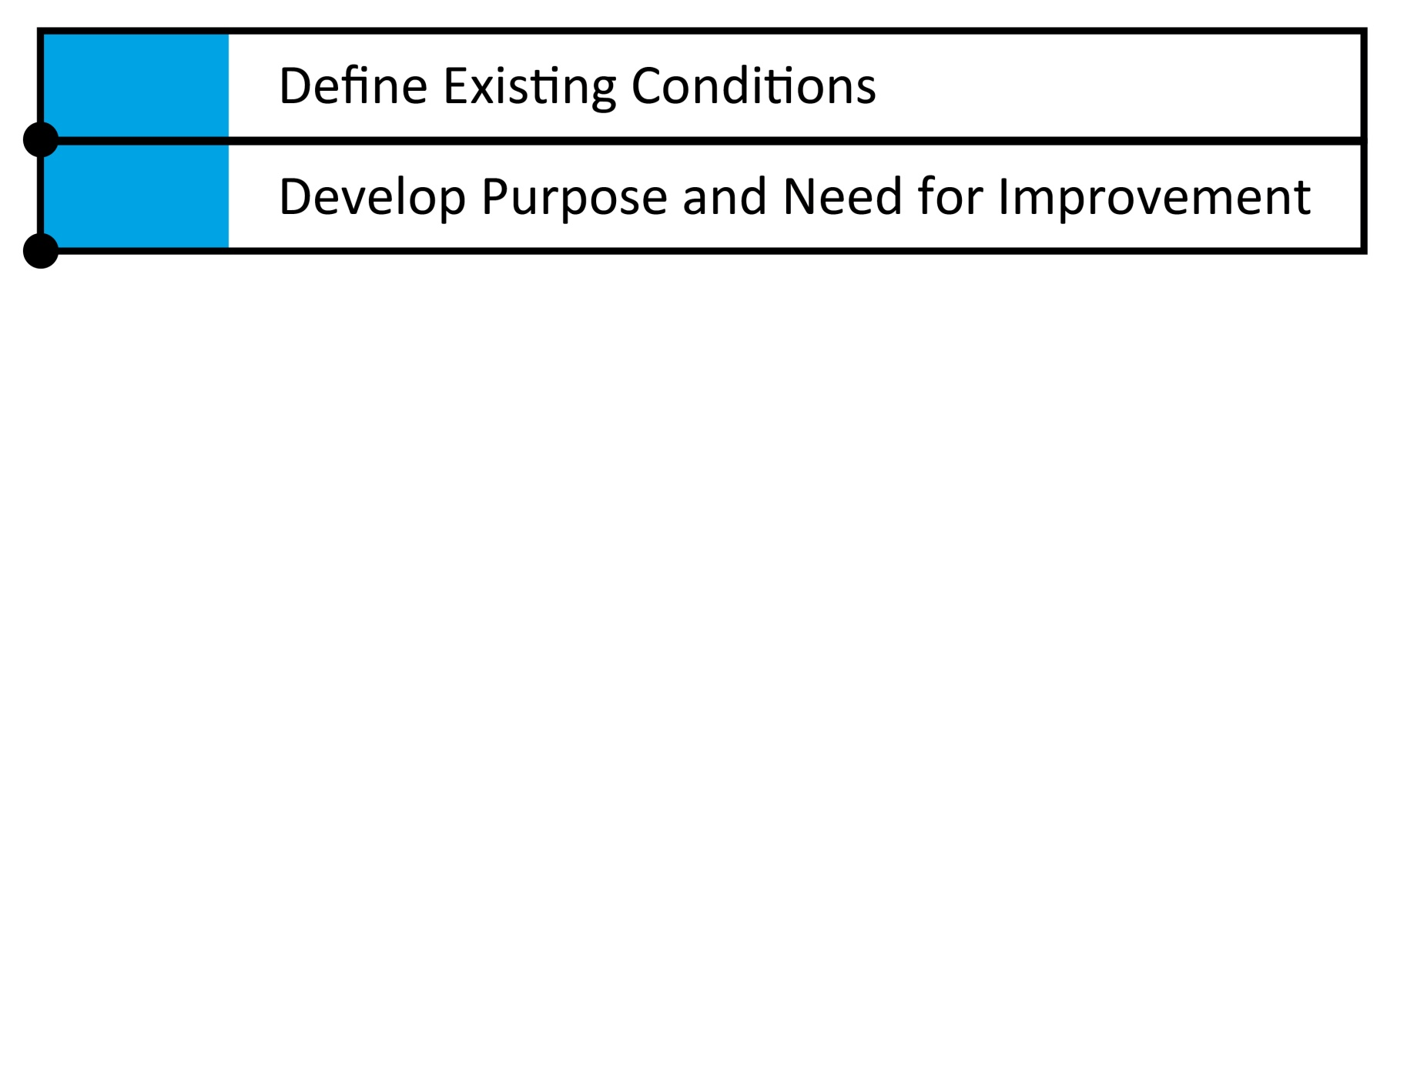
NEPA Milestones

Slide 24
Purpose & Need
Outlines the needs the project should address.
Justification for resource commitment.
Justification for environmental impacts.
Basis for eliminating alternatives.
Developed by Project Study Group & Regulatory Agencies.

Slide 25
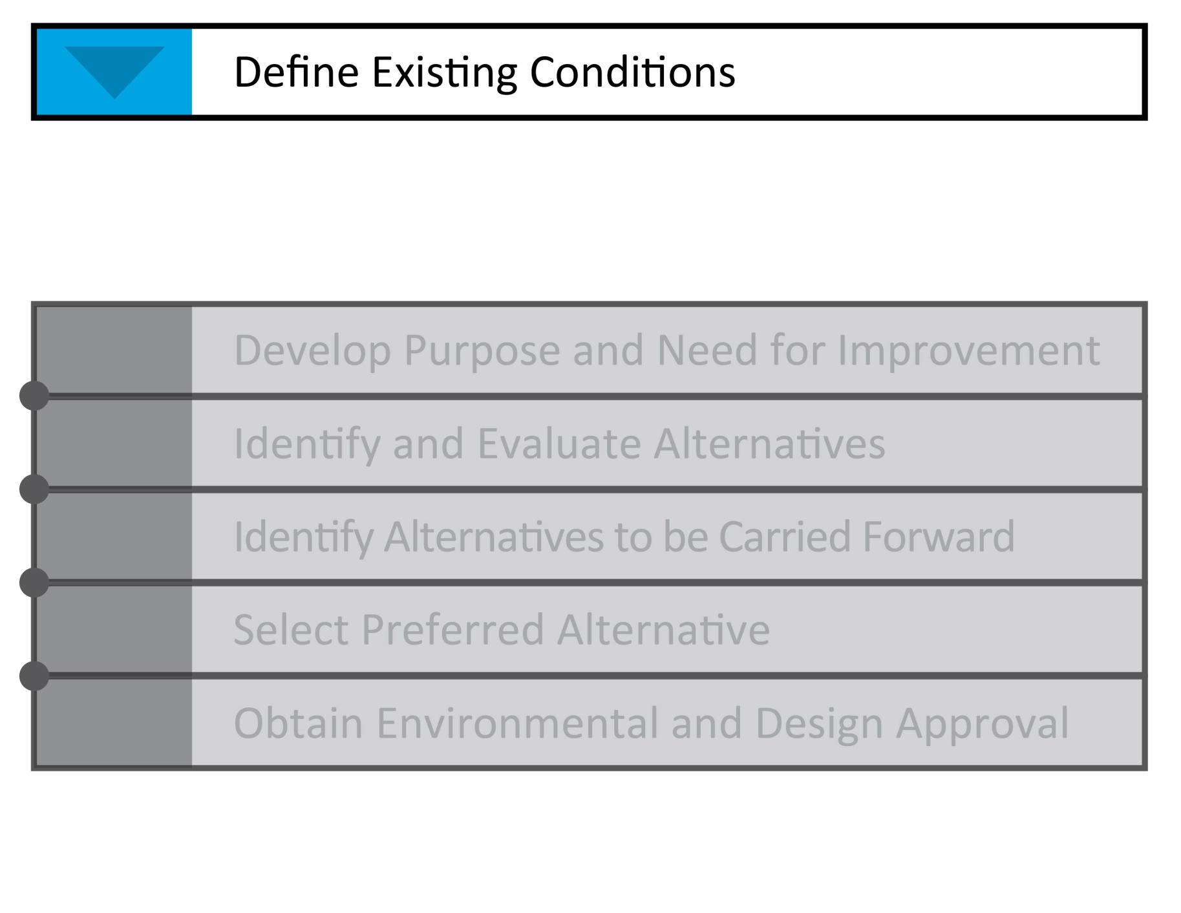
NEPA Milestones

Slide 26
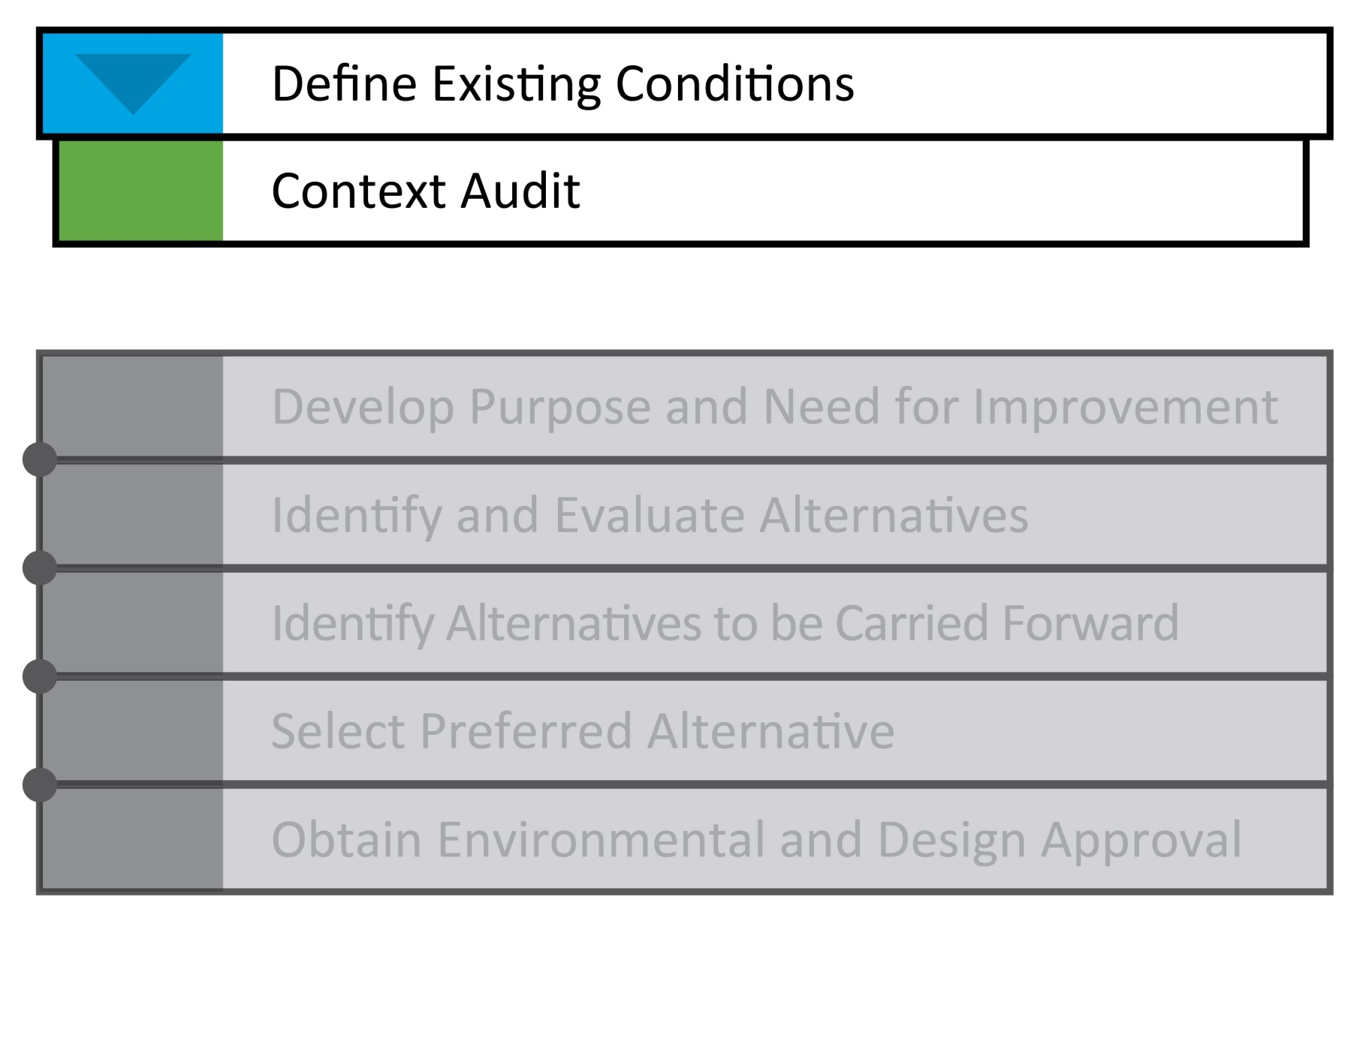
NEPA Milestones

Slide 27
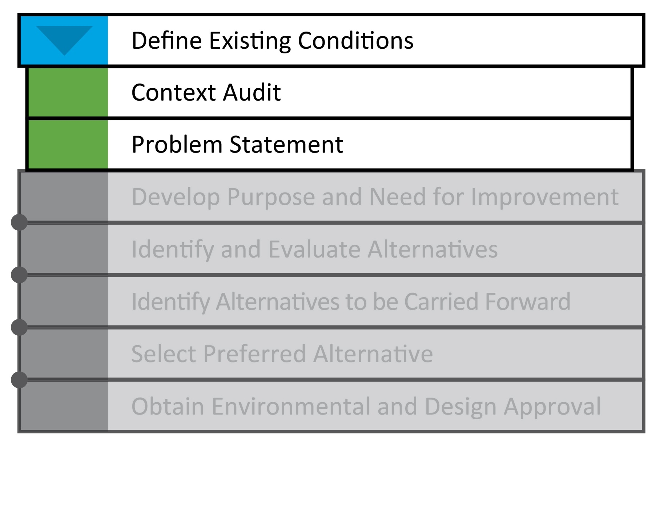
NEPA Milestones
Notes:
A Phase I Study is an in-depth investigation of improvement alternatives which considers social, economic, environmental, safety, serviceability, and cost factors. Several milestones are accomplished during the course of the Phase I Study, the first of which involves performing data collection, surveys, and public involvement in order to define the existing conditions. Next, a concise written purpose and need statement is prepared based on the identified needs. Using the purpose and need statement, improvement alternatives will be identified and evaluated to determine the extent of any environmental impacts. The most viable alternatives will be carried forward for further environmental analysis, and a preferred alternative will be selected.

Slide 28
What is a Problem Statement?
Clear statement of the transportation problems which can be solved by the project.
It does not define the preferred scope of improvement.
It is the foundation for achieving the Purpose & Need Milestone in NEPA process.

Slide 29
Existing Conditions

Slide 30
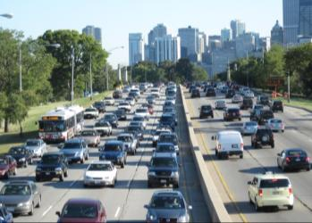
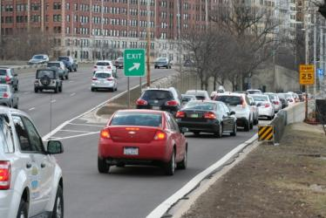
Existing Conditions - Traffic
NLSD is a critical traffic artery
Travel Demand = 70,000 to 155,000 vpd.
Significant traffic bottlenecks
Chicago Avenue
LaSalle Drive
Fullerton Parkway
Belmont Avenue
Irving Park Road
Notes:
Travel demand on the Drive is substantial, with volumes ranging from 70,000 vehicles per day near Hollywood Avenue to 155,000 vehicles per day near Oak Street. The result is significant congestion for many hours of the day at many of the cross street intersections along the Drive, including Chicago Avenue, LaSalle Drive, Fullerton Parkway, Belmont Avenue and Irving Park Road.

Slide 31
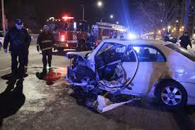
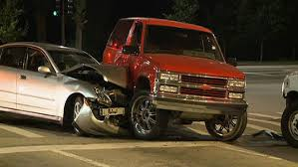
Existing Conditions - Safety
5-Year crash history:
5,800 crashes
17 fatal and 1,005 injury crashes
Average of 1,100 crashes/year.
Predominant Crash Types:
Rear End – 37%
Sideswipe – 21%
Fixed Object – 20%
Notes:
Oftentimes, congestion can result in safety concerns as is evidenced on North Lake Shore Drive. During the 5 year period from 2007 through 2011, approximately 5,800 crashes occurred along the Inner and Outer Drives including 17 crashes that resulted in fatalities. This is approximately 1,100 crashes per year or an average of three per day. Predominant crash types along Lake Shore Drive include rear-end and sideswipe collisions.

Slide 32
Existing Conditions - Safety
NLSD High Crash Locations:
Oak Street Curve (780 crashes)
LaSalle Drive Junction (540 crashes)
Fullerton Parkway Junction (450 crashes)
Belmont Avenue Junction (820 crashes)
Irving Park Road Junction (430 crashes)
Notes:
Each year, the State of Illinois produces a report that describes highway locations that exhibit the most pressing safety needs. This report, called the Five Percent Report, helps provide guidance on where safety investments are needed. In 2012, 80% of the study area was considered to be in the top 5% high crash segments in the State of Illinois for similar roadways.
Although many locations have substantial crash histories, the Belmont Avenue Junction and the Oak Street curve experience significant safety problems. At each of these locations, approximately 800 crashes occurred in the 5 year period from 2007 through 2011. On the Oak Street curve, just over half of the 800 crashes involved a vehicle collision with either the inner or outer barrier wall.

Slide 33
Existing Conditions - Safety
2012 State of Illinois Five Percent Report:
Locations in Illinois exhibiting pressing safety needs
80% of study area is classified as Five Percent Segment.
Notes:
Each year, the State of Illinois produces a report that describes highway locations that exhibit the most pressing safety needs. This report, called the Five Percent Report, helps provide guidance on where safety investments are needed. In 2012, 80% of the study area was considered to be in the top 5% high crash segments in the State of Illinois for similar roadways.
Although many locations have substantial crash histories, the Belmont Avenue Junction and the Oak Street curve experience significant safety problems. At each of these locations, approximately 800 crashes occurred in the 5 year period from 2007 through 2011. On the Oak Street curve, just over half of the 800 crashes involved a vehicle collision with either the inner or outer barrier wall.

Slide 34
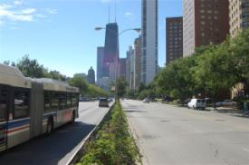
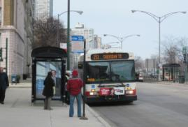
Existing Conditions - Transit
NLSD is also a critical transit corridor
Outer Drive: 42,300 riders/day
7 express bus routes
Inner Drive: 26,500 riders/day 2 local bus routes
Total Corridor Transit Ridership = 69,000 riders/day
Notes:
North Lake Shore Drive is also an important transit corridor. A total of 9 bus routes serve the Inner and Outer Drives and carry nearly 69,000 riders per day.

Slide 35
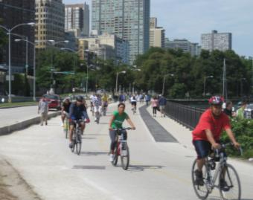
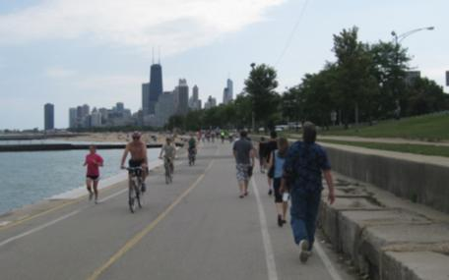
Existing Conditions – Lakefront Trail
Lakefront Trail serves:
Bicycle commuters
Recreational users
Tourists
Peak Trail Usage:
31,000 users*/day at highest use areas
Safety:
Collisions are frequent & sometimes
severe.
*Users = pedestrians, cyclists and others.
Notes:
Another important transportation facility located within the Lake Shore Drive corridor is the Lakefront Trail. The Lakefront Trail not only serves recreational users but also a significant amount of bicycle commuters. Recent counts indicate that on a typical weekday during nice weather, usage of the trail exceeds 31,000 users per day at areas of highest use. Safety is also a concern because of the varying types of users competing for space on the trail as well as due to conflicts at the entrance and exit points. Although there is not a system in place to track trail collisions, users and local hospitals indicate collisions are frequent and sometimes severe.

Slide 36
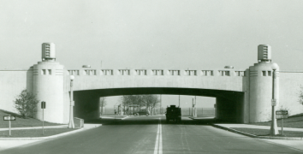
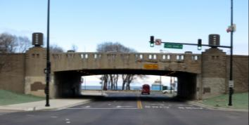
Existing Conditions - Infrastructure
Much of NLSD was
constructed in the 1930s
under the WPA Program.
Most bridges and tunnels
have reached the end of their
useful design lives.
Notes:
As previously mentioned, much of Lake Shore Drive was constructed in the 1930s under the Works Progress Administration and as such the aging infrastructure has reached the end of its useful design life.

Slide 37
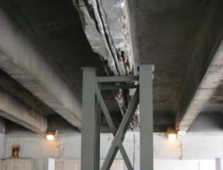
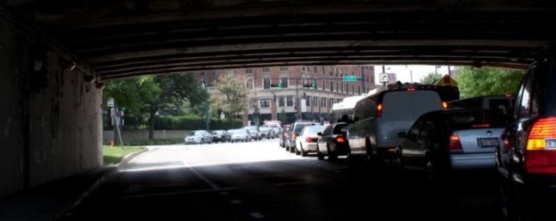
Existing Conditions - Infrastructure
Some bridges are in poor
structural condition.
Many bridges are functionally
obsolete for traffic and pedestrian
demands.
Notes:
Several of the bridges are in poor structural condition and many are obsolete for today’s traffic and pedestrian demands.

Slide 38
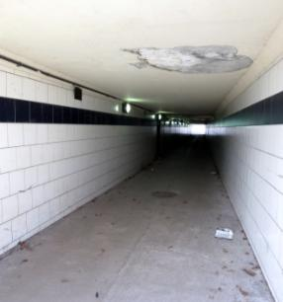
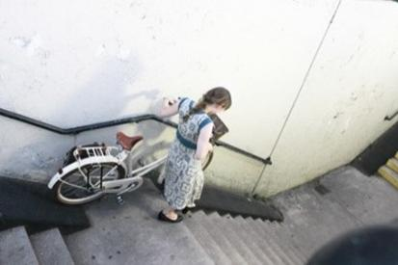
Existing Conditions - Infrastructure
Most tunnels are inadequately
sized for pedestrian/bicycle
demands.
Many tunnels do not meet ADA requirements.
Notes:
This includes the pedestrian tunnels along the Drive, many of which do not meet the requirements of the Americans with Disabilities Act.

Slide 39
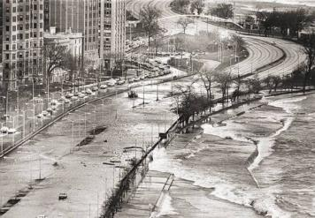
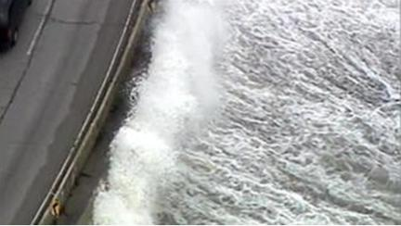
Existing Conditions - Infrastructure
Wave action, flooding and ice buildup are regular problems along some portions of NLSD and the Lakefront Trail.
Notes:
Portions of the Drive and Lakefront Trail are also regularly subjected to wave action, flooding and ice build-up due to poor shoreline protection measures.

Slide 40
Public Meeting Summary

Slide 41
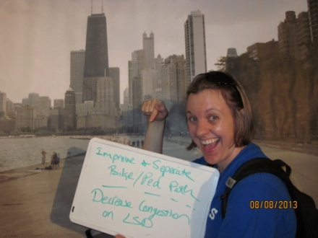
Public Meeting Summary
3 Public Meetings on August 6th, 7th and 8th
Gill Park
Peggy Notebaert Nature Museum
Truman College
440 Attendees
Over 450 written comments
Comment Forms
Postcards to the Drive
Share Your Ideas
Needs Assessment Mapping Exercise
Online comments

Slide 42
Public Meeting Summary
Themes We Heard:
Reduce congestion and improve mobility.
Improve safety.
Improve transit.
Improve east-west access.
Provide expanded and safer bicycle & pedestrian facilities.
Notes:
All the input we received, could generally be summarized into a few themes which include….

Slide 43
Problem Statement
Now Your Turn
BREAKOUT SESSION
Notes:
We’ve heard from the general public and now we want your input to help craft a Problem Statement….

Slide 44
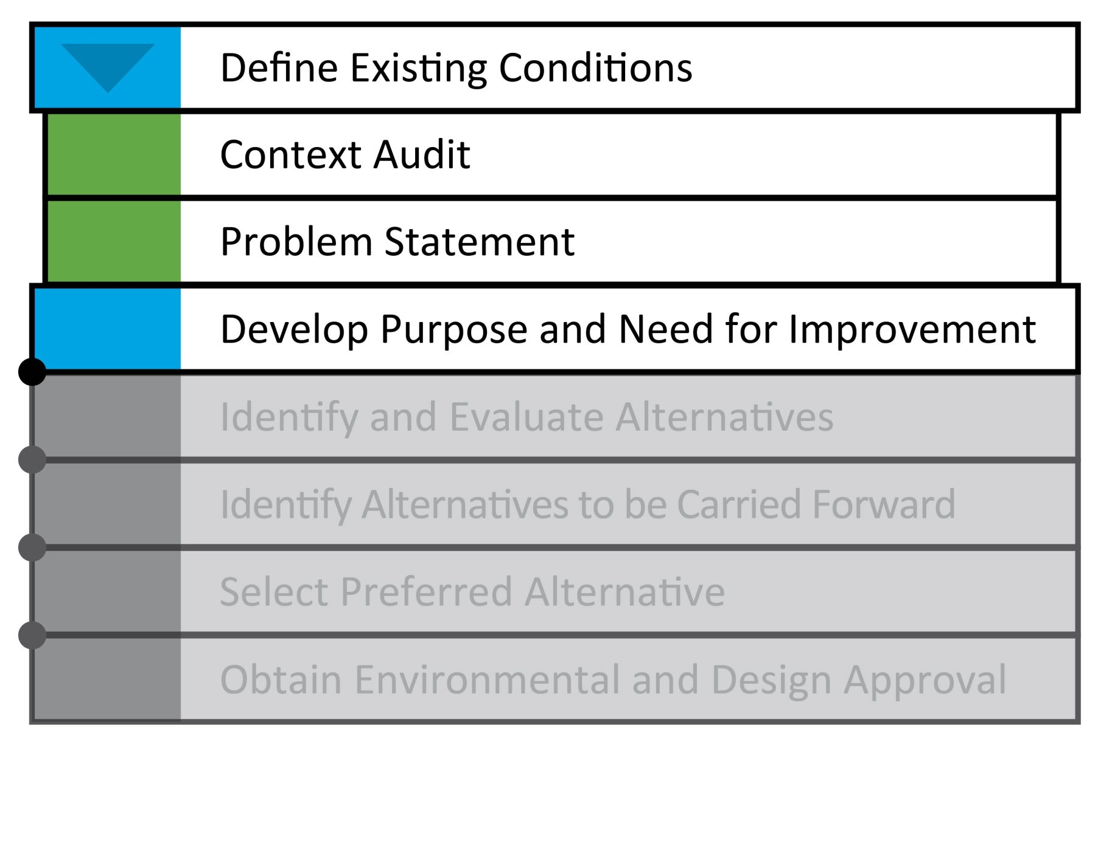
NEPA Milestones
Notes:
We have your input, we are meeting with 6 more Task Forces, we will combine all of the feedback into a concise problem statement and send that out to everyone….

Slide 45
Next Steps
2014 Meetings
Problem Statement
Purpose & Need
Development of Alternatives
2014 Public Meetings
Provide Continued Input & Outreach

Slide 46
North Lake Shore Drive
Thank You
www.northlakeshoredrive.org
Phone: 312-561-3140
Email: info@northlakeshoredrive.org
Facebook.com/NorthLakeShoreDrive
Twitter: @n_lakeshoredr

